Slide 1


WELCOME
To our
Presentation

Slide 2

Presented To
Dr. Shamim H Ripon
Professor Department of Computer Science & Engineering

Slide 3

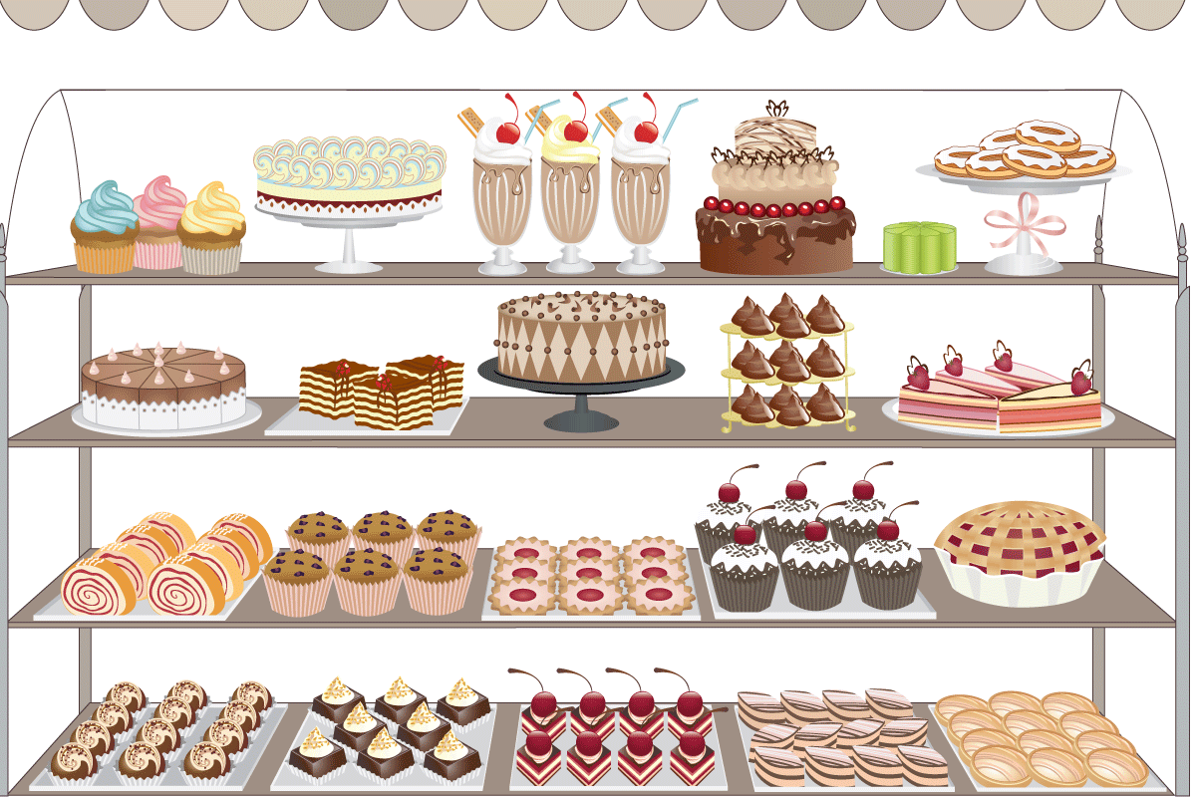
She Bee
Our Project
Cake Shop Management System

Slide 4
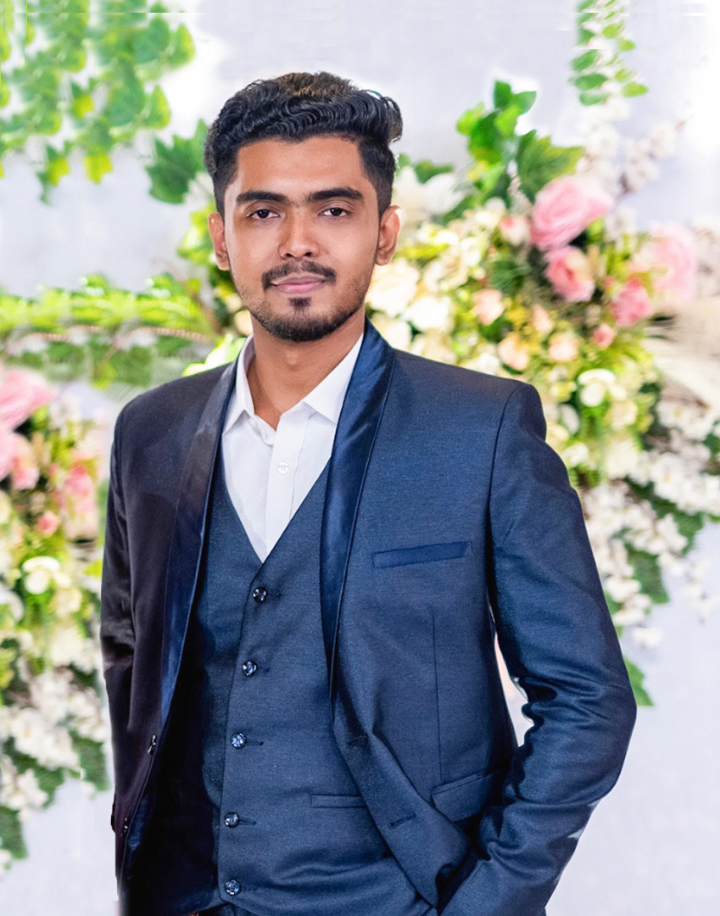
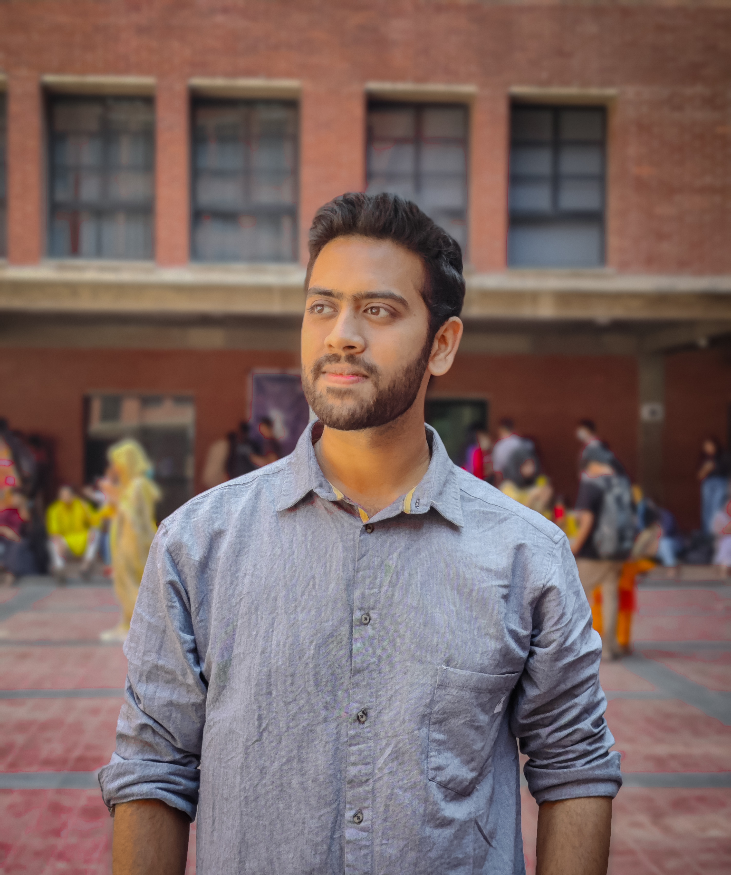


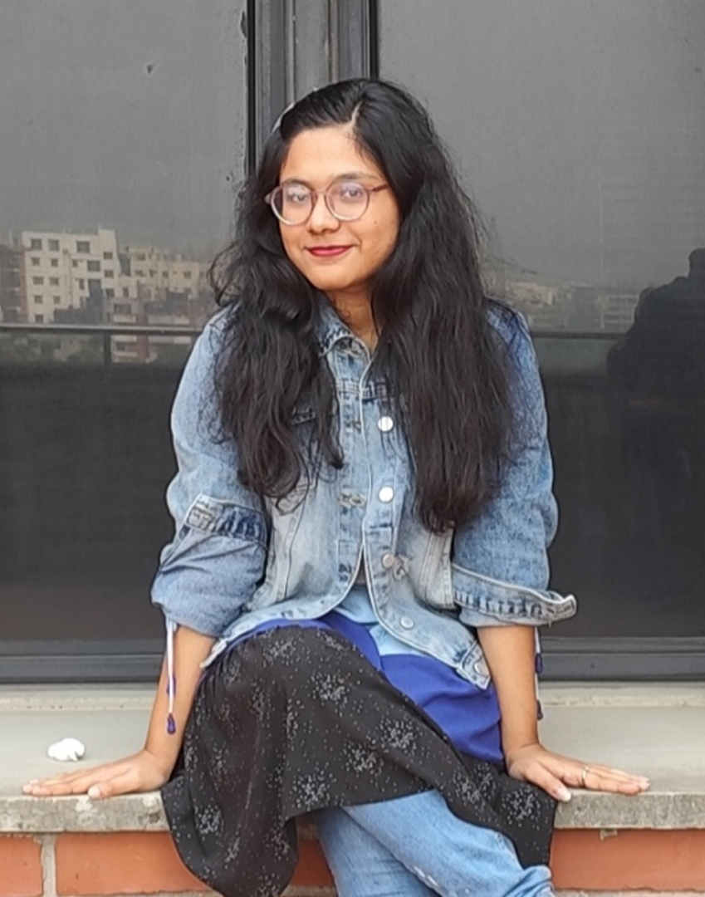

Mohammad Tahmid Noor
2021-3-60-026
B M Shahria Alam
2021-3-60-016
Tasmiah Rahman Orpa
2021-3-60-021
Sidratul Moontaha
2021-3-60-48
Our Team

Slide 5



Visions to achieve
3.Customer
Account create and login
My account
Featured product
Add to cart
Order
payment
1. Product categorized
2. Admin panel
Dashboard
Flavour insert and update
Catagory insert and update
Coupun insert update
Product insert and edit
Order management
4. Display product
5. Shop
6. About us
7. Local store
8. Our services

Slide 6

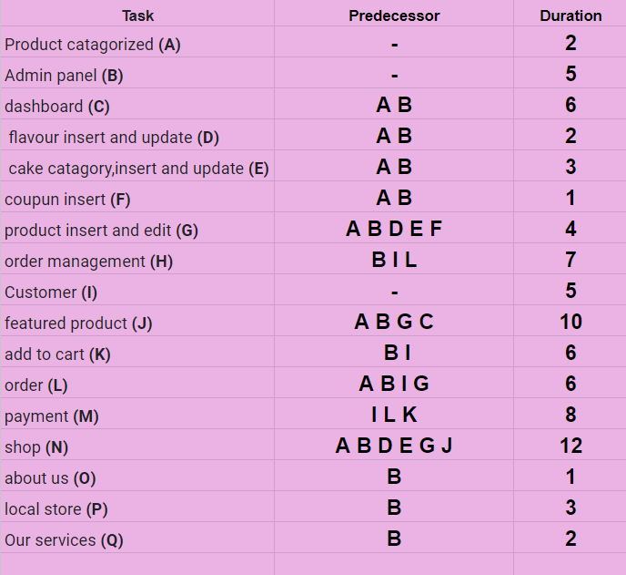
Activity
Table

Slide 7
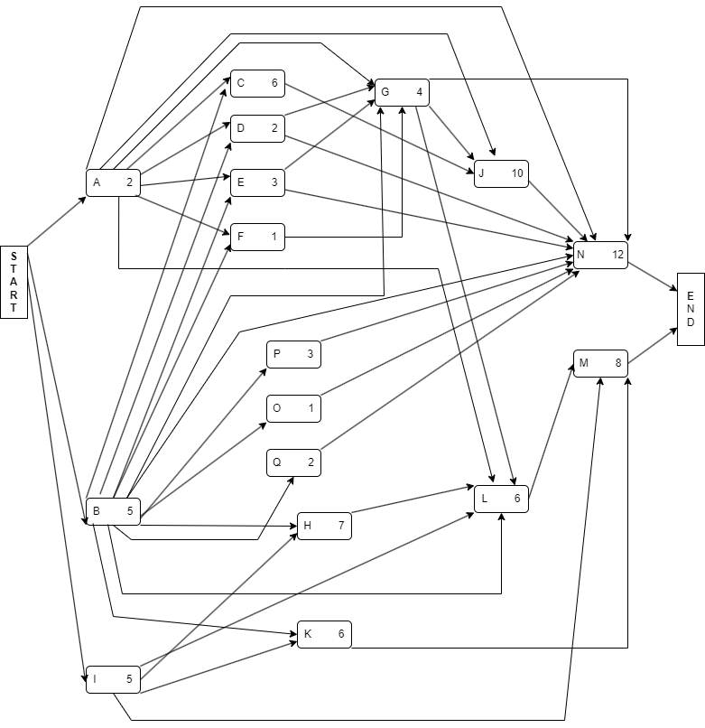

Project
Diagram

Slide 8
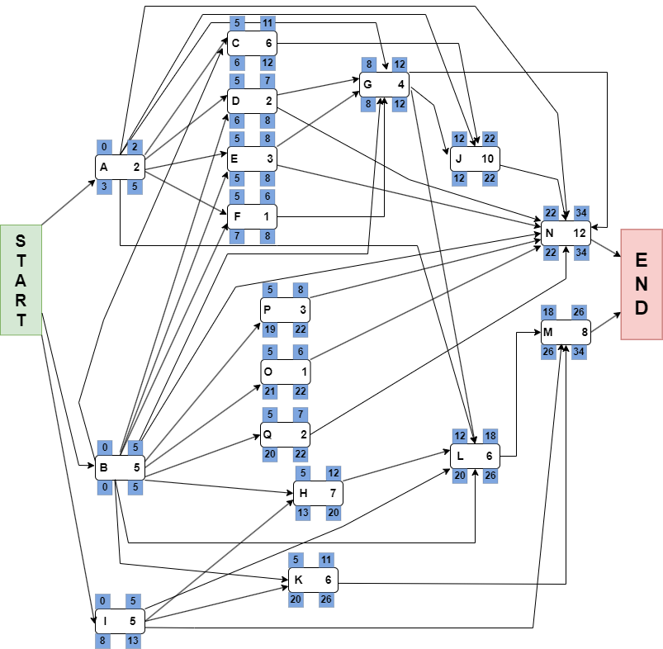
Project
Diagram

Slide 9
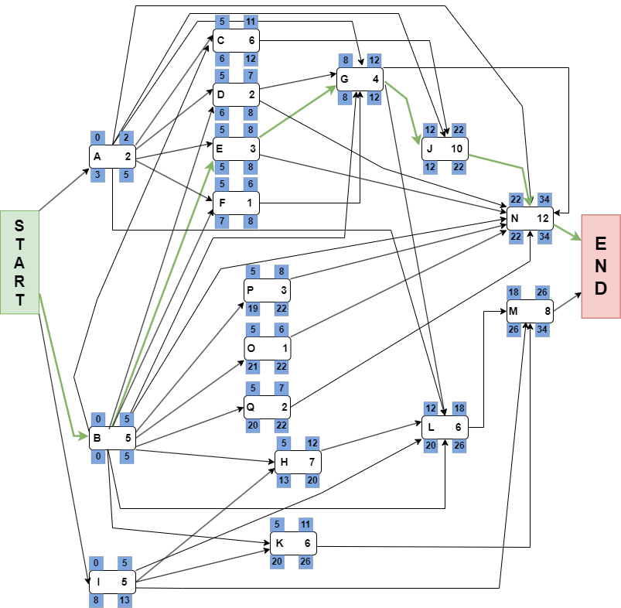
Project
Diagram

Slide 10
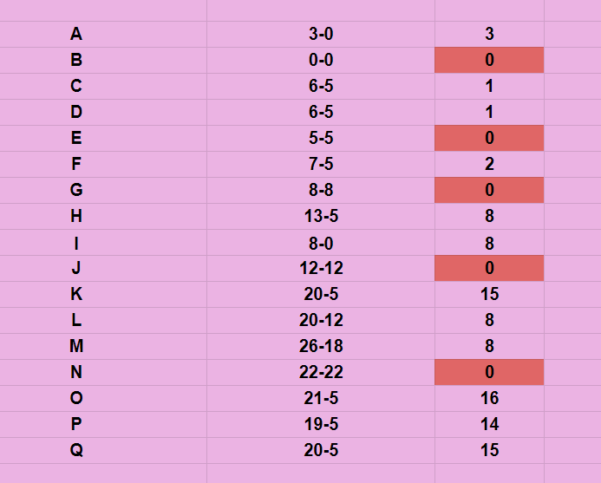
Critical Path :
B E G J N

Slide 11
Thank You

